Slide 1

Intermediate Code Generator
CD Project Review-1
18-09-2026
 | Under the Guidance of Dr.Uma Shankari Designation Department of CSE, KLH CSE Bowrampet Campus
Team Members B. Chetna Chaudhary — 2420030098 Aashna Begum — 2420030647 M. Asleshitha — 2420030740 K. Vasavi — 2420030785

Slide 2
Outline of Project Work
Focus
Introduction
Literature Survey
Challenges
Research Objectives
Conclusion & Future Work
References
Publications Details

Slide 3
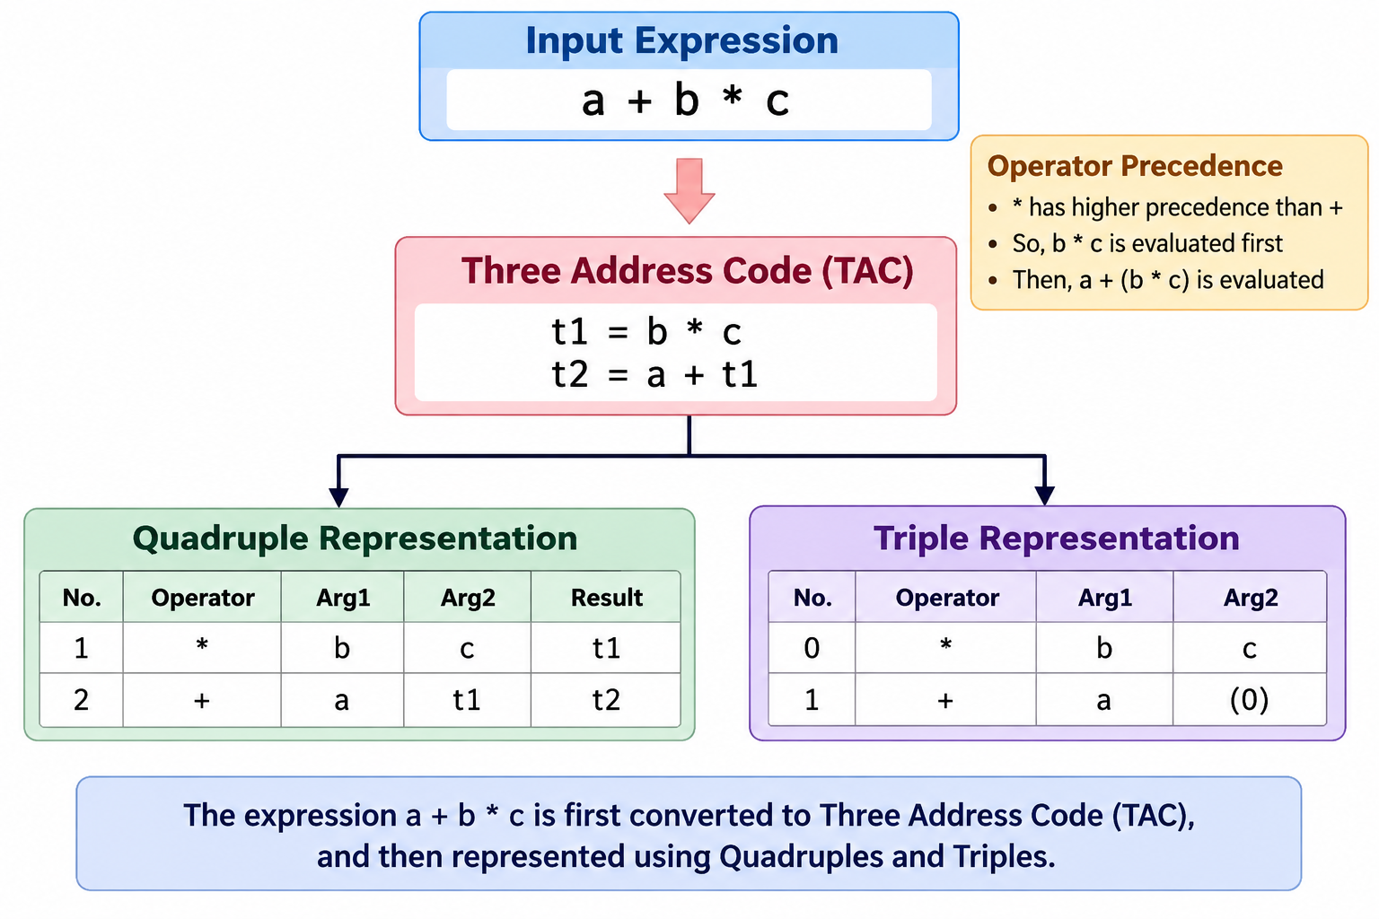
Problem Statement
High-level expressions require conversion into an intermediate representation.
Manually generating TAC, Quadruples, and Triples is difficult and time-consuming.
Complex expressions may cause errors in operator precedence and intermediate results.
An automated system is needed to analyze expressions and generate intermediate code.
The system should provide TAC, Quadruple, and Triple representations in a clear format.

Slide 4
Problem Gap Identification
High-level arithmetic expressions are written in a form that is convenient for programmers but cannot be directly used by later compiler stages.
Existing Challenge
Complex expressions contain multiple operators and operands.
Operator precedence must be correctly maintained.
Expressions need to be converted into a structured intermediate representation.
Manual generation of intermediate code is time-consuming and error-prone.
Students often find the relationship between expressions, TAC, Quadruples, and Triples difficult to visualize.
Proposed Solution
Develop a Python-based Intermediate Code Generator that automatically:
Expression → TAC(stores the result in a temporary variable)→ Quadruples(result has its own column)+ Triples(Instead of having a Result column, Triples use the row number itself.)

Slide 5
Objectives
A Python-based compiler design system that converts high-level arithmetic expressions into structured intermediate representations.
Main Components
Expression Input
Lexical Analysis
Syntax Analysis
Syntax Directed Translation
Three Address Code Generation
Quadruple Generation
Triple Generation
Output Visualization
The abstract describes the expected system as one that accepts an arithmetic expression and automatically produces TAC, Quadruple, and Triple representations

Slide 6
Innovation, Creativity, and Novelty
A compiler translates high-level programming languages into machine-understandable code.
Intermediate Code Generation is an important phase between source-code analysis and final target-code generation.
Intermediate code provides a machine-independent representation of the source program.
Three Address Code (TAC) represents complex expressions using simple instructions and temporary variables.
Quadruples and Triples provide structured representations of TAC.
This project demonstrates the conversion of arithmetic expressions into these intermediate representations.

Slide 7
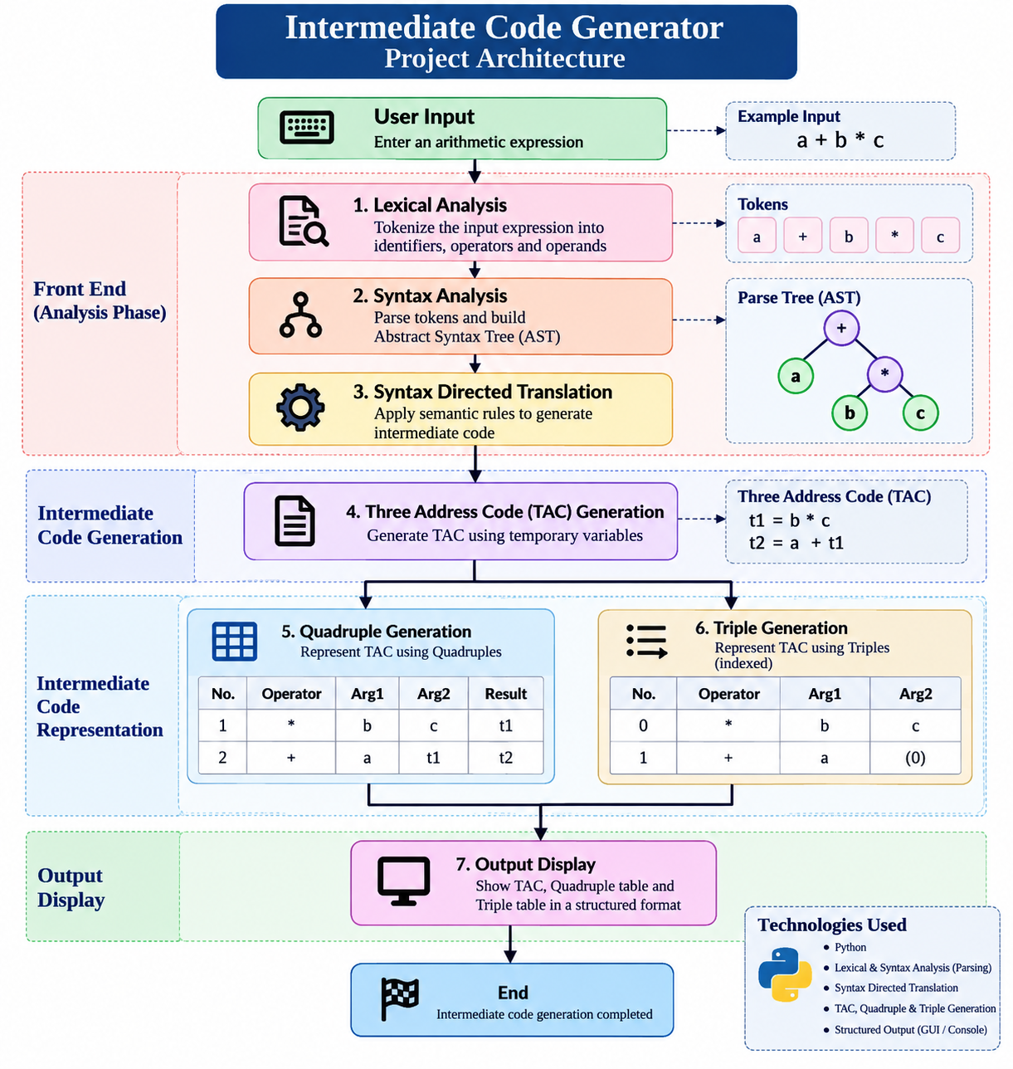
Architecture

